Slide 1
K-mode clustering
Faculty: Dr. Hemant Kathania
Machine learning
By:
Aashish kumar (B190048EC)
Santosh kumar (B190064EC)
Prashu kumar sharma (B190043EC)

Slide 2
Contents
Introduction to Clustering
KMode clustering
How does the KModes algorithm work?
Elbow Method
Example
Disadvantages
KModes implementation(Python)

Slide 3
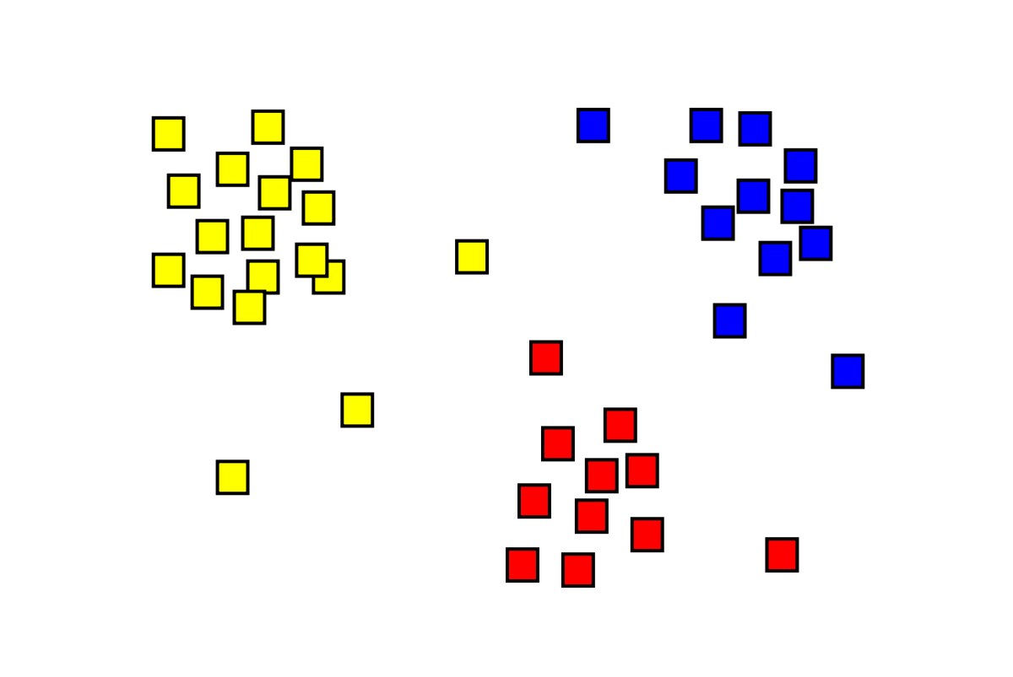
Introduction
Clustering is the task of dividing the data points into a number of groups such that data points in the same groups are more similar to other data points in the same group than those in other groups or, the aim is to segregate groups with similar traits and assign them into clusters.

Slide 4
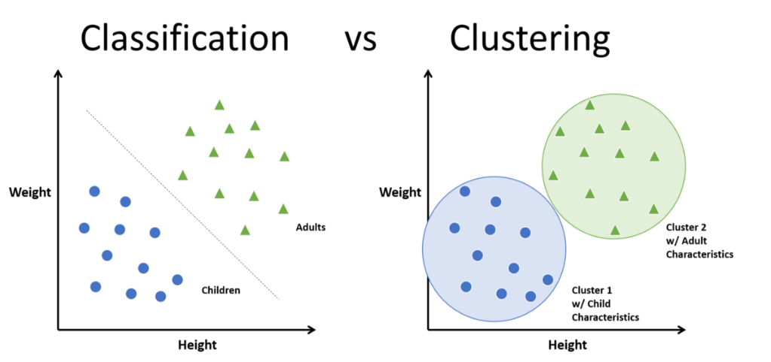
Classification Vs Clustering
Classification | Clustering
Type of supervised learning. Known number of classes. Based on training set. Used to classify future observation. | Type of unsupervised learning. Unknown number of classes. No prior knowledge. Used to understand data.

Slide 5
KMode clustering
KModes clustering is one of the unsupervised Machine Learning algorithms that is used to cluster categorical variables.
Need of KModes clustering :
We have KMeans clustering then why do we need KModes clustering?
KMeans uses mathematical measures (distance) to cluster continuous data. The lesser the distance, the more similar our data points are. Centroids are updated by Means. But for categorical data points, we cannot calculate the distance. So we go for KModes algorithm. It uses the dissimilarities(total mismatches) between the data points. The lesser the dissimilarities the more similar our data points are. It uses Modes instead of means.

Slide 6
How does KMode clustering works?
The K-Modes clustering process consists of the following steps:
Randomly select k unique objects as the initial cluster centers (modes).
Calculate the distances between each object and the cluster mode; assign the object to the cluster whose center has the shortest distance.
Repeat until all objects are assigned to clusters.
Please select a new mode for each cluster and compare it with the previous mode. If different, go back to Step 2; otherwise, stop.

Slide 7
Optimal Value for K
Elbow Method
Determining the optimal number of clusters is a fundamental issue in partitioning clusters .
Elbow method is the solution.
In Elbow Method the distortion score is computed,the sum of square distances from each point to its nearest centroid.
When it is plotted then its looks like an arm ,then an elbow(Point of inflection on curve) is the optimum value of “K”.

Slide 8
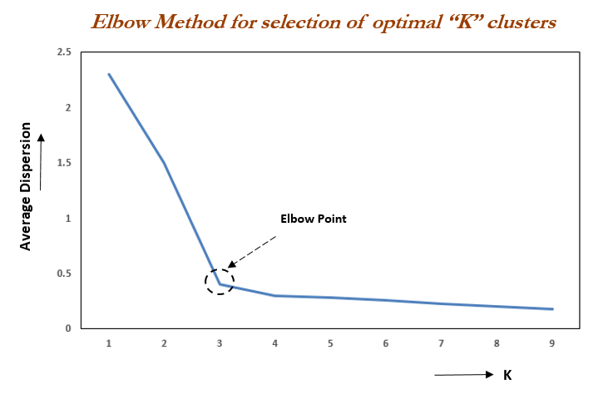
Optimal Value for K

Slide 9
Example
Let consider a data of some individuals of college and we will classify them into “Student ” and “Faculty” with respect to their data..
 | Age (>24 OR <24) | Qualification
0 | Less | Intermediate
1 | Less | Intermediate
2 | More | Ph.D
3 | Less | B.tech

Slide 10
Example
4 | More | Ph.D
5 | Less | Intermediate
6 | Less | Intermediate
7 | More | Ph.D
8 | More | M.tech
9 | More | Ph.D
For Epoch 1 ,we will select centroid as [Less,Intermediate] and [More,Ph.D]

Slide 11
Process
Calculating Distance for different Row and Clustering them accordingly
Data | C1 (Less,Intermediate) | C2 (More,PhD) | Cluster
D0(Less,Intermediate) | 0 | 2 | C1
D1(Less,Intermediate) | 0 | 2 | C1
D2(More,Ph.D) | 2 | 0 | C2
D3(Less,B.Tech) | 1 | 2 | C1

Slide 12
Process
Continue….
Data | C1 (Less,Intermediate) | C2 (More,PhD) | Cluster
D4 (More,Ph.D) | 2 | 0 | C2
D5(Less,Intermediate) | 0 | 2 | C1
D6(Less,Intermediate) | 0 | 2 | C1
D7(More,Ph.D) | 2 | 0 | C2
D8(Less,Ph.D) | 1 | 1 | C2
D9(More,Ph.D) | 2 | 0 | C2

Slide 13
Process
C1 | 0 | Less | Intermediate
 | 1 | Less | Intermediate
 | 3 | Less | B.tech
 | 5 | Less | Intermediate
C2 | 2 | More | Ph.D
 | 4 | More | Ph.D
 | 6 | More | Ph.D
 | 7 | More | Ph.D
 | 8 | More | M.tech
 | 9 | More | Ph.D

Slide 14
Process
In Epoch 2 ,again most frequent will be set as Centroid
Since for C1 most frequent term is “Less” and “Intermediate” so centroid will be [Less,Intermediate]
Same follow in C2 case “More” and “Ph.D” is mode so Centroid is
[More ,Ph.D] .

Slide 15
Disadvantages
Disadvantages :
Get confused when distance is same.
A large number of dimensions and huge sets of data items can be complex
In the absence of a distance measure, its value must be defined, which is problematic in multi-dimensional domains

Slide 16
Reference
Reference :
www.analyticsvidhya.com
Youtube
wikipedia

